Slide 1


CHOICES Presentation
(April 2017)

Slide 2


Slide 3
Outline
Why JMU?
Why Honors at JMU?
Honors Curriculum Overview.
Honors Admissions Process.
Introduction of Current Honors Students.
Q&A.

Slide 4

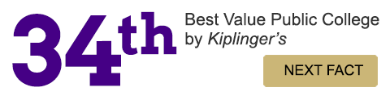

Why JMU?
JMU is a Community Engaged University focused on educating enlightened citizens.
JMU is focused on created high-impact and inquiry-based learning environments.
Engaged Universities like JMU have the potential to give students a virtually unmatched education.

Slide 5
Why Honors at JMU?
Our honors program builds upon JMU’s strengths!!
  An engaged university focused on undergraduate student success.
  Focused on high-impact and inquiry-based learning practices.
  Focused on educating enlightened citizens.
Honors College Mission:
  Our mission is to prepare thoughtful and engaged citizens equipped to lead, innovate, and make meaningful contributions in a complex and ever changing global community.
  We expect our students to grow as leaders over time in their individual areas and be engaged in life long learning.

Slide 6
Additional Features of Honors at JMU
Small, Unique Classes
Areas-of-Emphasis Tracks
Scholarship Support for Signature Summer Experiences
Opportunities for Peer, Faculty & Alumni Mentoring
Honors Advising
Preparation for Graduate, Professional, Post-Baccalaureate Training
Hillcrest House Lab & Lounge
Priority Registration
Honors Living Learning Community Opportunities.
Many tools to help our students create a series of linked transformative experiences!!!

Slide 7
Honors Curriculum Overview
1st Year
2nd Year
3rd Year
Honors GenEds (6 CH)
Honors Seminars (6 CH)
4th Year
Honors electives (9 CH)
Senior Honors Project (6 CH)
HON 100
Honors enhances a student’s normal JMU experience and coursework.

Slide 8
Honors Curriculum Overview
Honors at JMU allows students the opportunity to:
  Create unique pathways through the curriculum.
  Link curricular and co-curricular components together.
  Explore inter- and cross-disciplinary studies outside of a traditional major.
Honors students have the chance to create a series of linked transformative experiences!!!
Honors acts as a catalyst for students to achieve their long-term professional and personal goals.

Slide 9
Honors Admissions Process
Highly Competitive
    ~1000 applications
    Freshman class restricted to ~200
Separate Application Required (with essay submissions)
    Deadlines:
      November 30th (Early Action)
      February 28th (Regular Decision)
The Average Accepted Student Profile:
    Superior grades in all of their core courses, strong AP or DE coursework, strong essay responses, and demonstrated leadership activities in school and/or the community.
Additional Entry Points for Honors:
    Track II (Freshmen & Sophomores)
    Track III (Select Juniors)

Slide 10



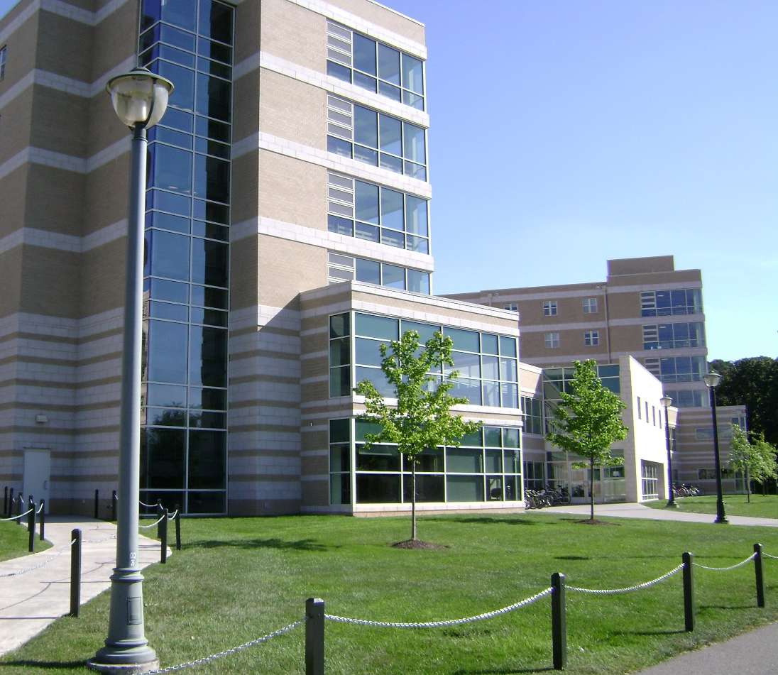
Huber Residential
Learning Community
Designed for First-Year Pre-Professional Health Students
We hope you’ll apply! On-line Application opens April 1st!
Shenandoah
Hall
Social Determinants of Health
Community Service Learning
Interprofessional Perspectives
Career Exploration
Reflection
Collaborative Learning
Academic Success
Courses for Huber RLC Members
Fall 2017: IPE 201H, 1 credit
Health Professionals in Diverse Communities
Spring 2018: IPE 202H, 2 credits
Health Care Service in Diverse Communities
pph@jmu.edu

Slide 11
Current Honors College Students
(Discussion Questions)
Who are you and where is home?
What are your majors/minors and graduation year?
What drew you to JMU?
What drew you to choosing Honors at JMU?
What Honors Experience has impacted you the most?
What are your future plans?

Slide 12

REMINDER
Honors Open House
11:00 – 3:00 today at Hillcrest House

Slide 13
Track II Option
    Open to current JMU Freshmen and first semester Sophomores
Separate Application Required (with essay and transcript and curriculum plan submissions)
    Approximate Deadline: October and April
Requires the completion of 18 hours of Honors coursework in addition to the Senior Honors Project (24 credit hours total).
All Track II students are expected to complete three Honors courses during their first year in the program. Enrollment in an Honors Area of Emphasis seminar during the Fall enrollment period is strongly suggested.

Slide 14
Track III Option
Open to select JMU Juniors
Intended for students wanting to focus solely on independent research leading to the completion of a Senior Honors Project.
Application Process:
  Register for 499A in the second semester of their Junior year through the department of their major.
  Submit the Senior Honors Project Application with Research Proposal to the Honors Program office by the stated semester deadline.

Slide 15
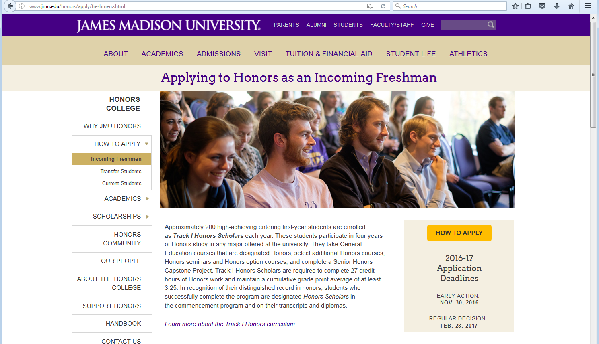
Honors Admissions Process
(http://www.jmu.edu/honors/apply/freshmen.shtml)

Slide 16
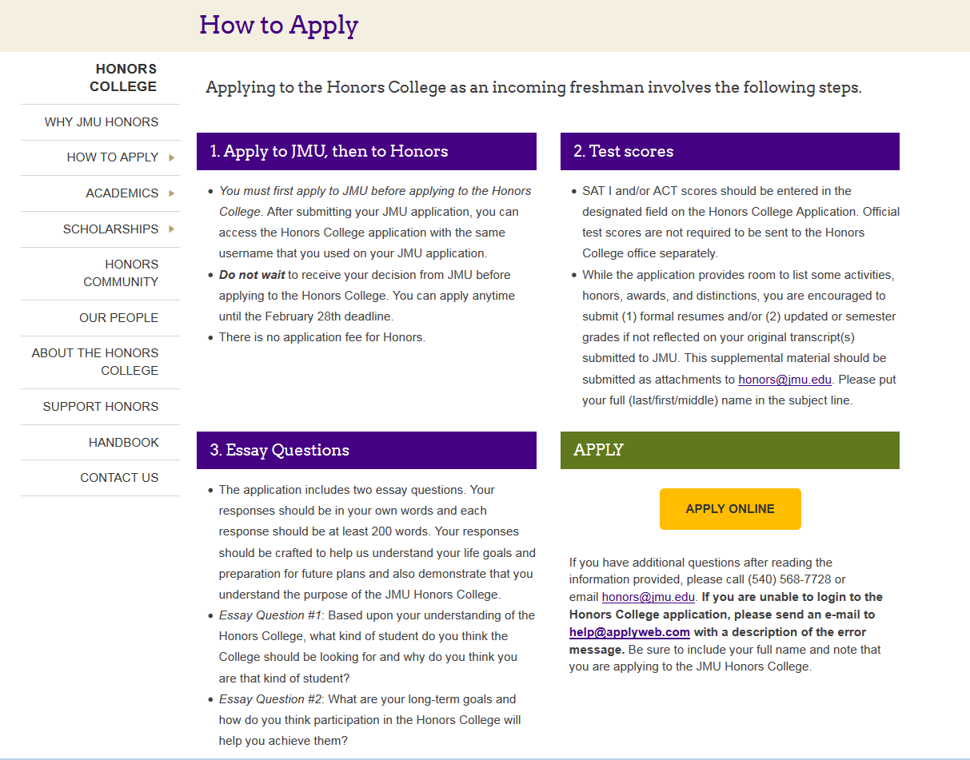
Honors Admissions Process
(http://www.jmu.edu/honors/apply/how-to-apply.shtml)

Slide 17
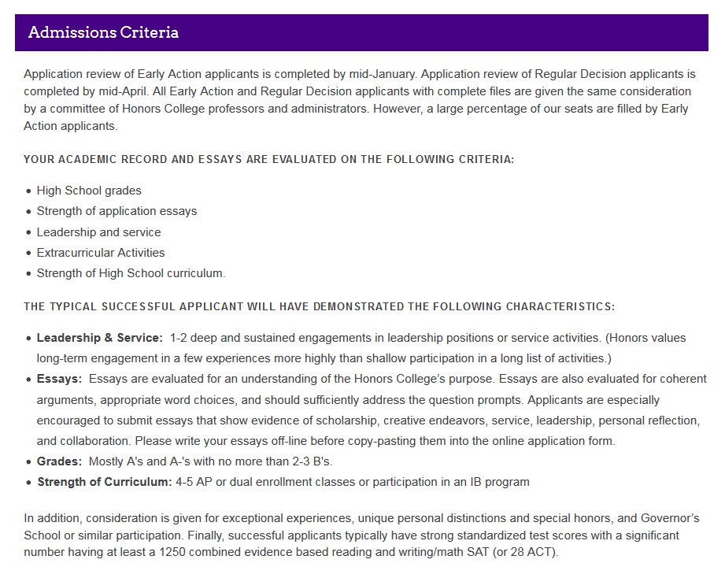
Honors Admissions Process
(http://www.jmu.edu/honors/apply/freshmen.shtml)

Slide 18
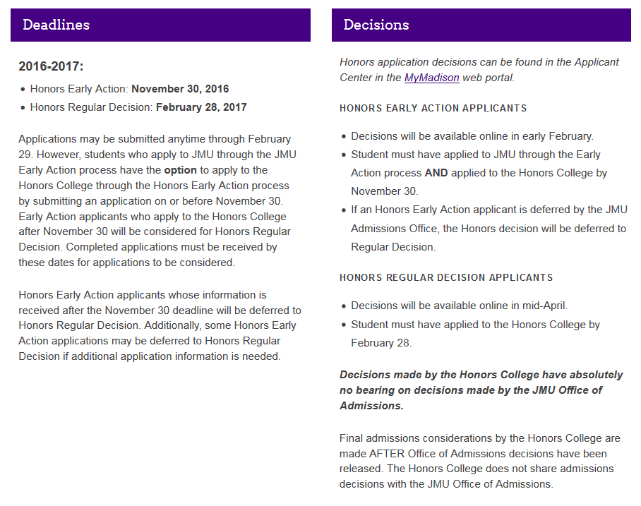
Honors Admissions Process
(http://www.jmu.edu/honors/apply/freshmen.shtml)

Slide 19
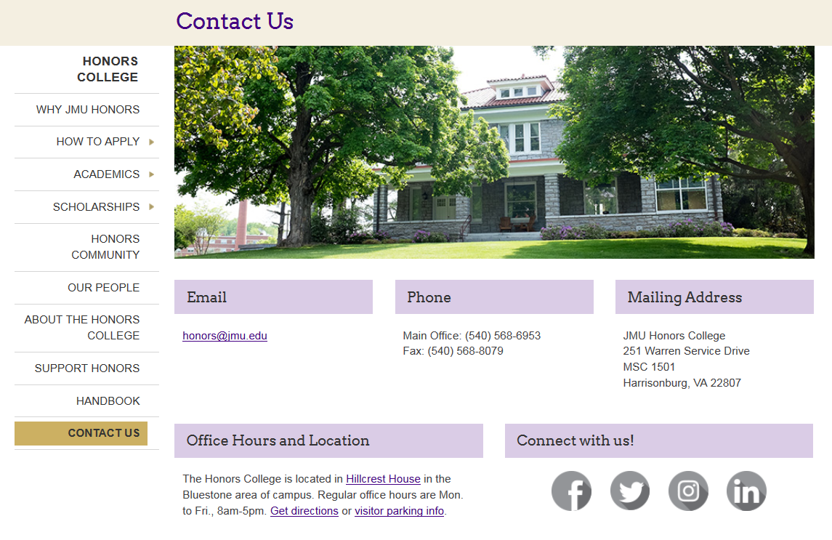
How to Contact Us
(www.jmu.edu/honors)

