Slide 1

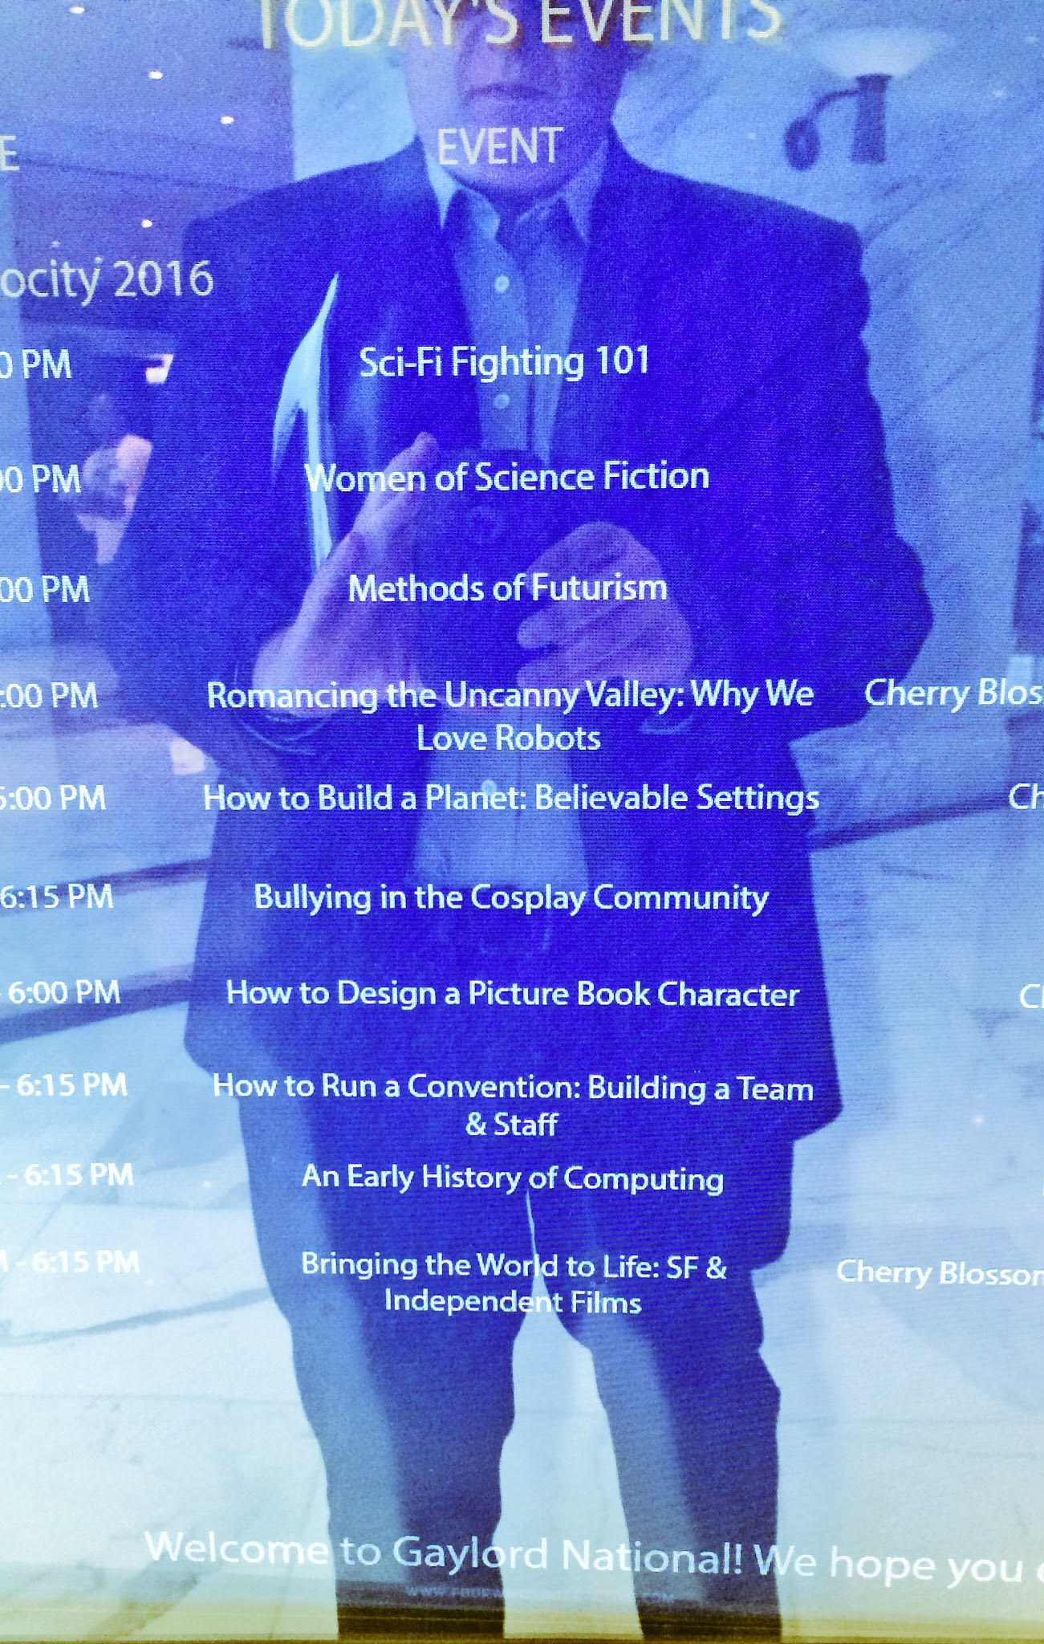
SOCIAL MEDIA FOR SCHOLARSHIP
PHIL FRANA
JAMES MADISON UNIVERSITY

Slide 2
Personal Branding
THE ARTIFICIAL OTHER

Slide 3
Bartle on Communities
Community of Interest
Community of Practice
Community of Commitment
People with the same individual goals and interests group together as a means of furthering those aims.
Members view the community as offering more than simply a means to an end, but of having intrinsic value itself.
Members work together on projects that are important to the aims or shared vision of the community, investing significant time and effort for the benefit of the community as a whole.

Slide 4
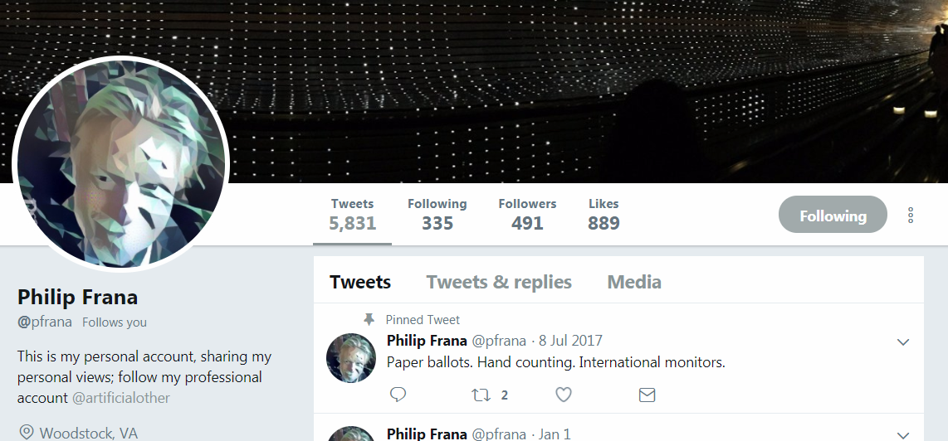

Slide 5
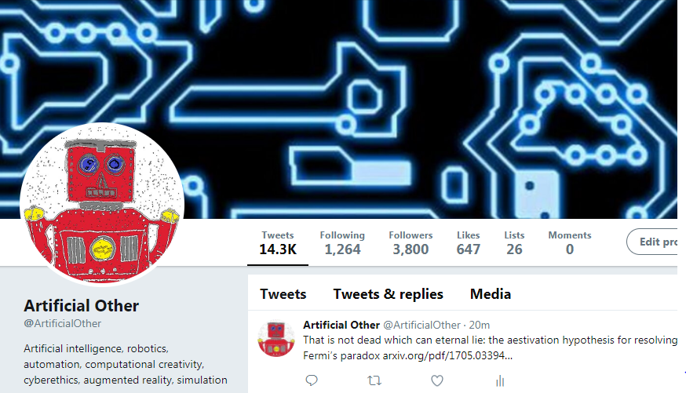

Slide 6
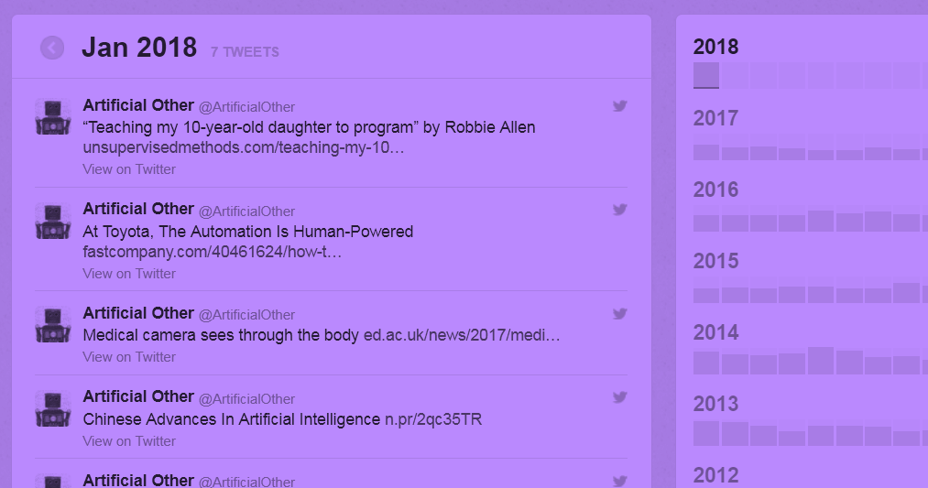
Twitter Archive

Slide 7
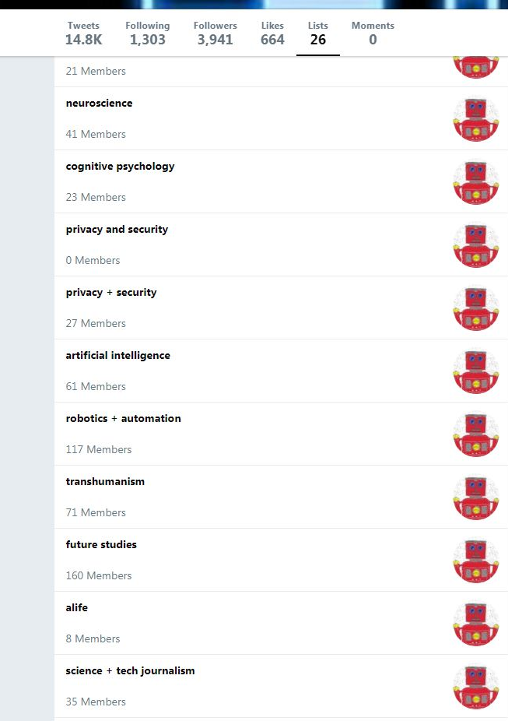
Twitter Lists

Slide 8
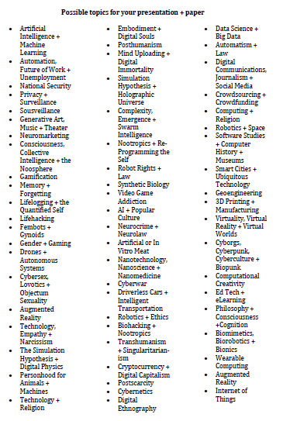
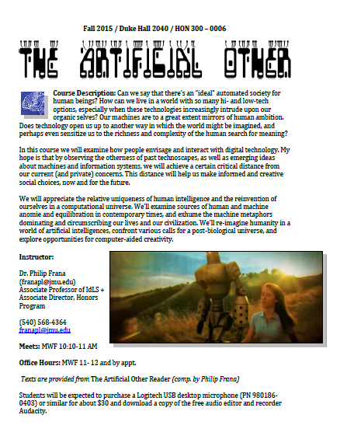

Slide 9
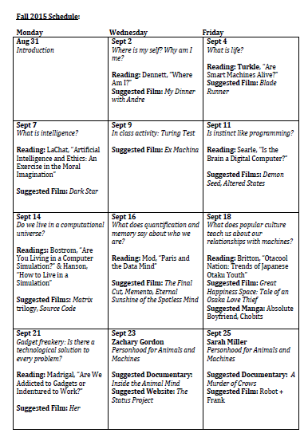
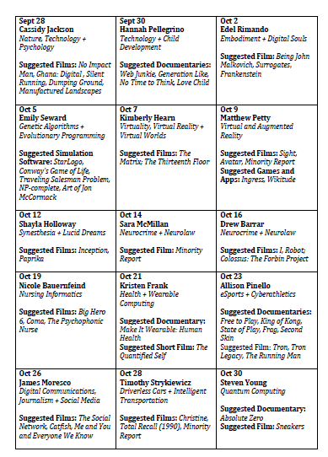
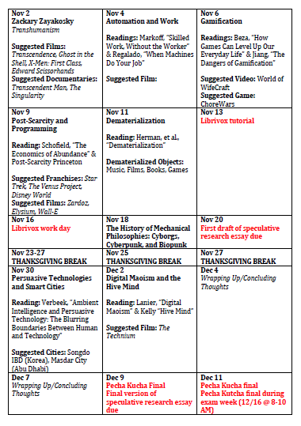

Slide 10
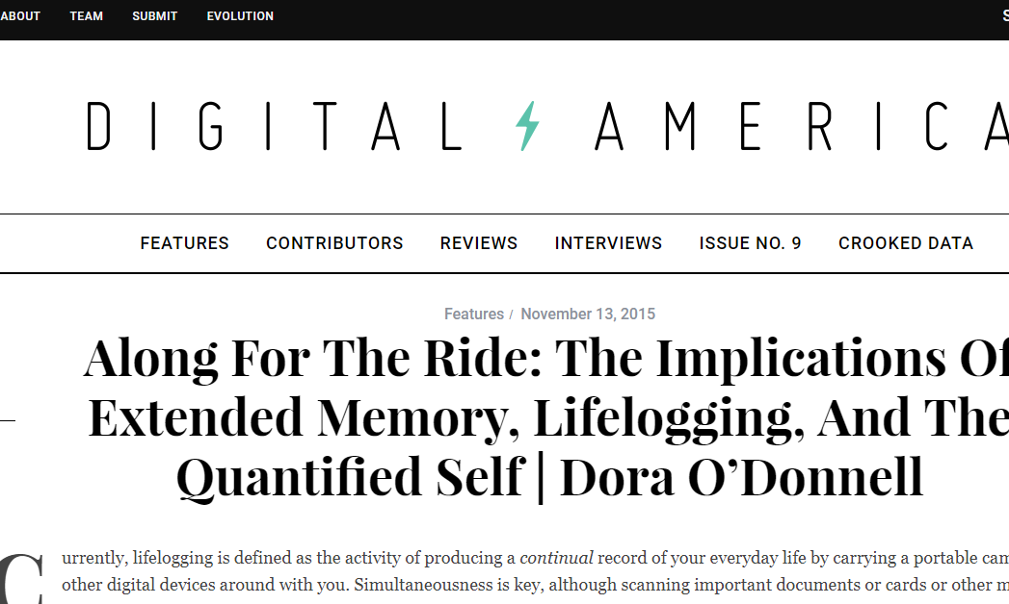

Slide 11
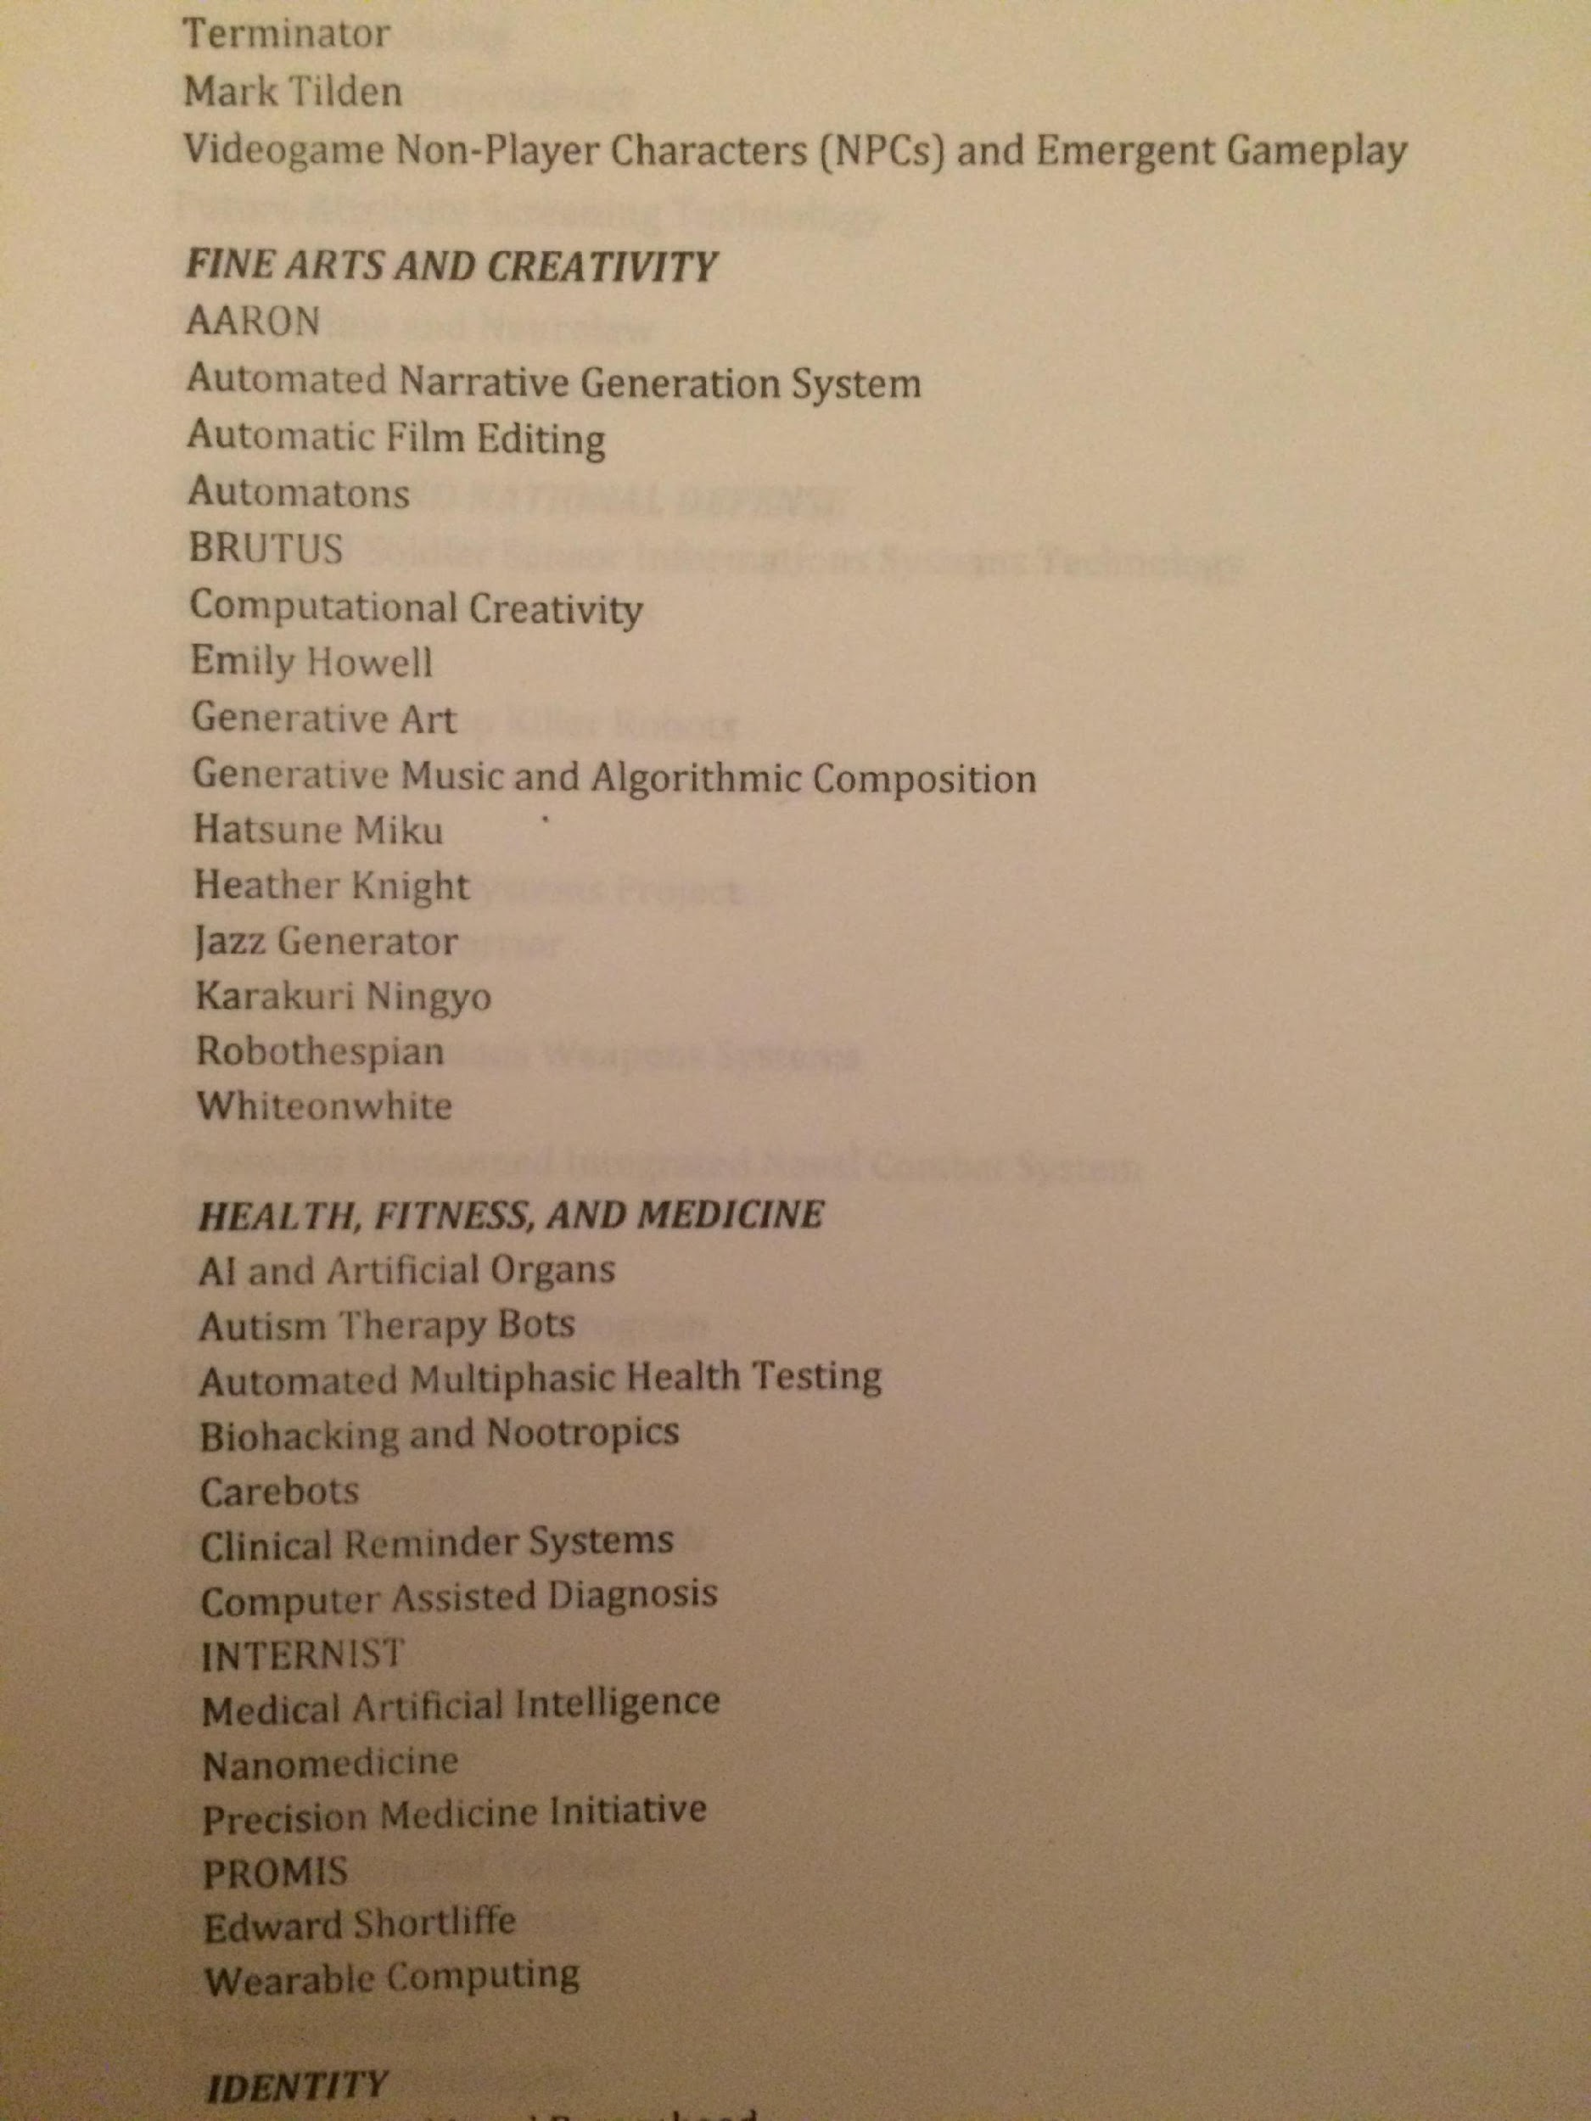
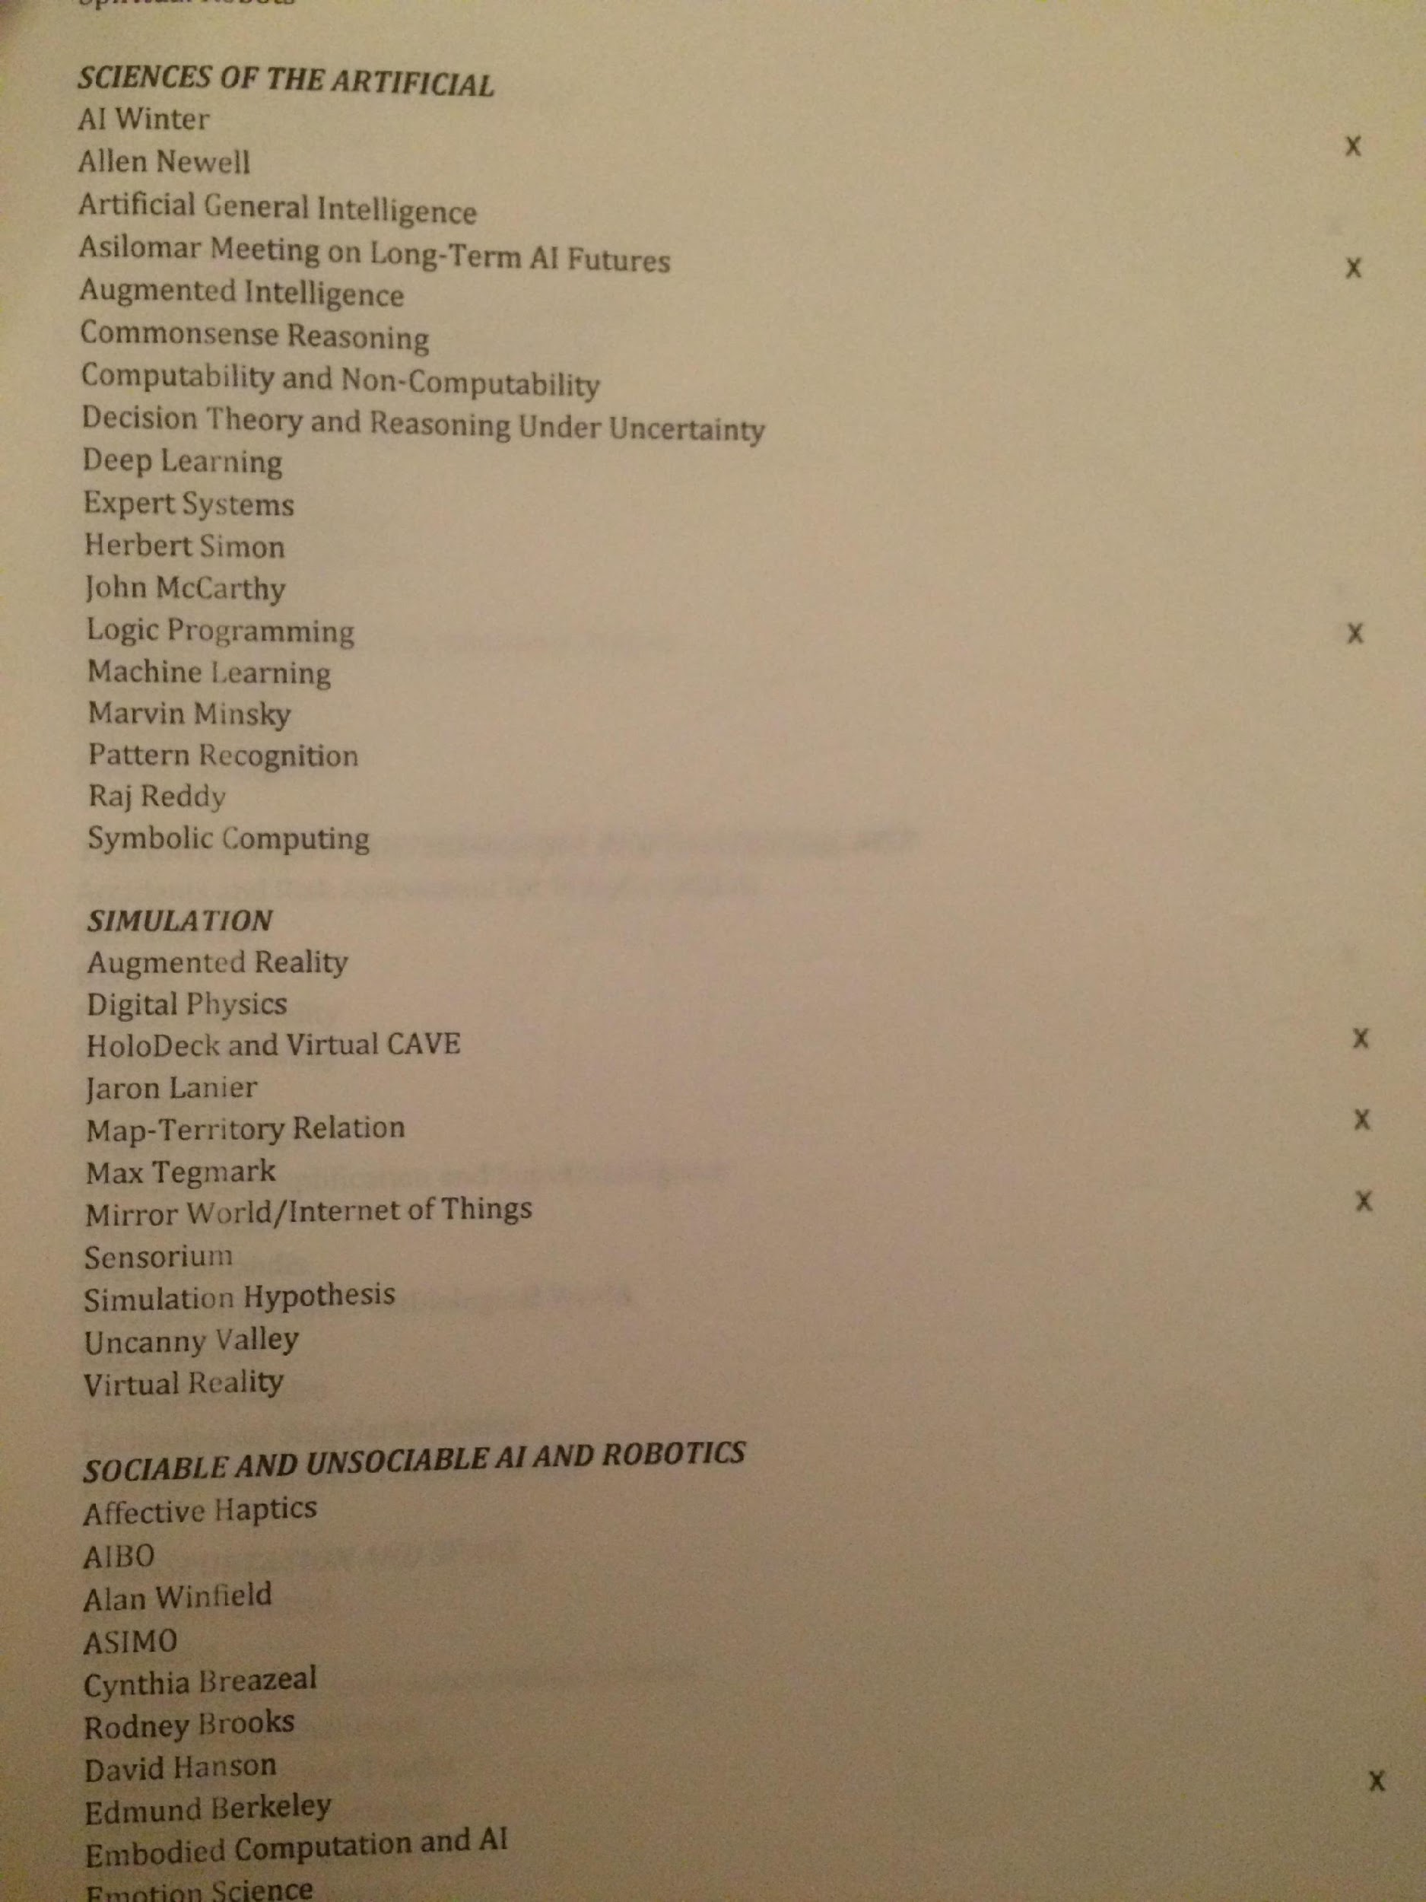
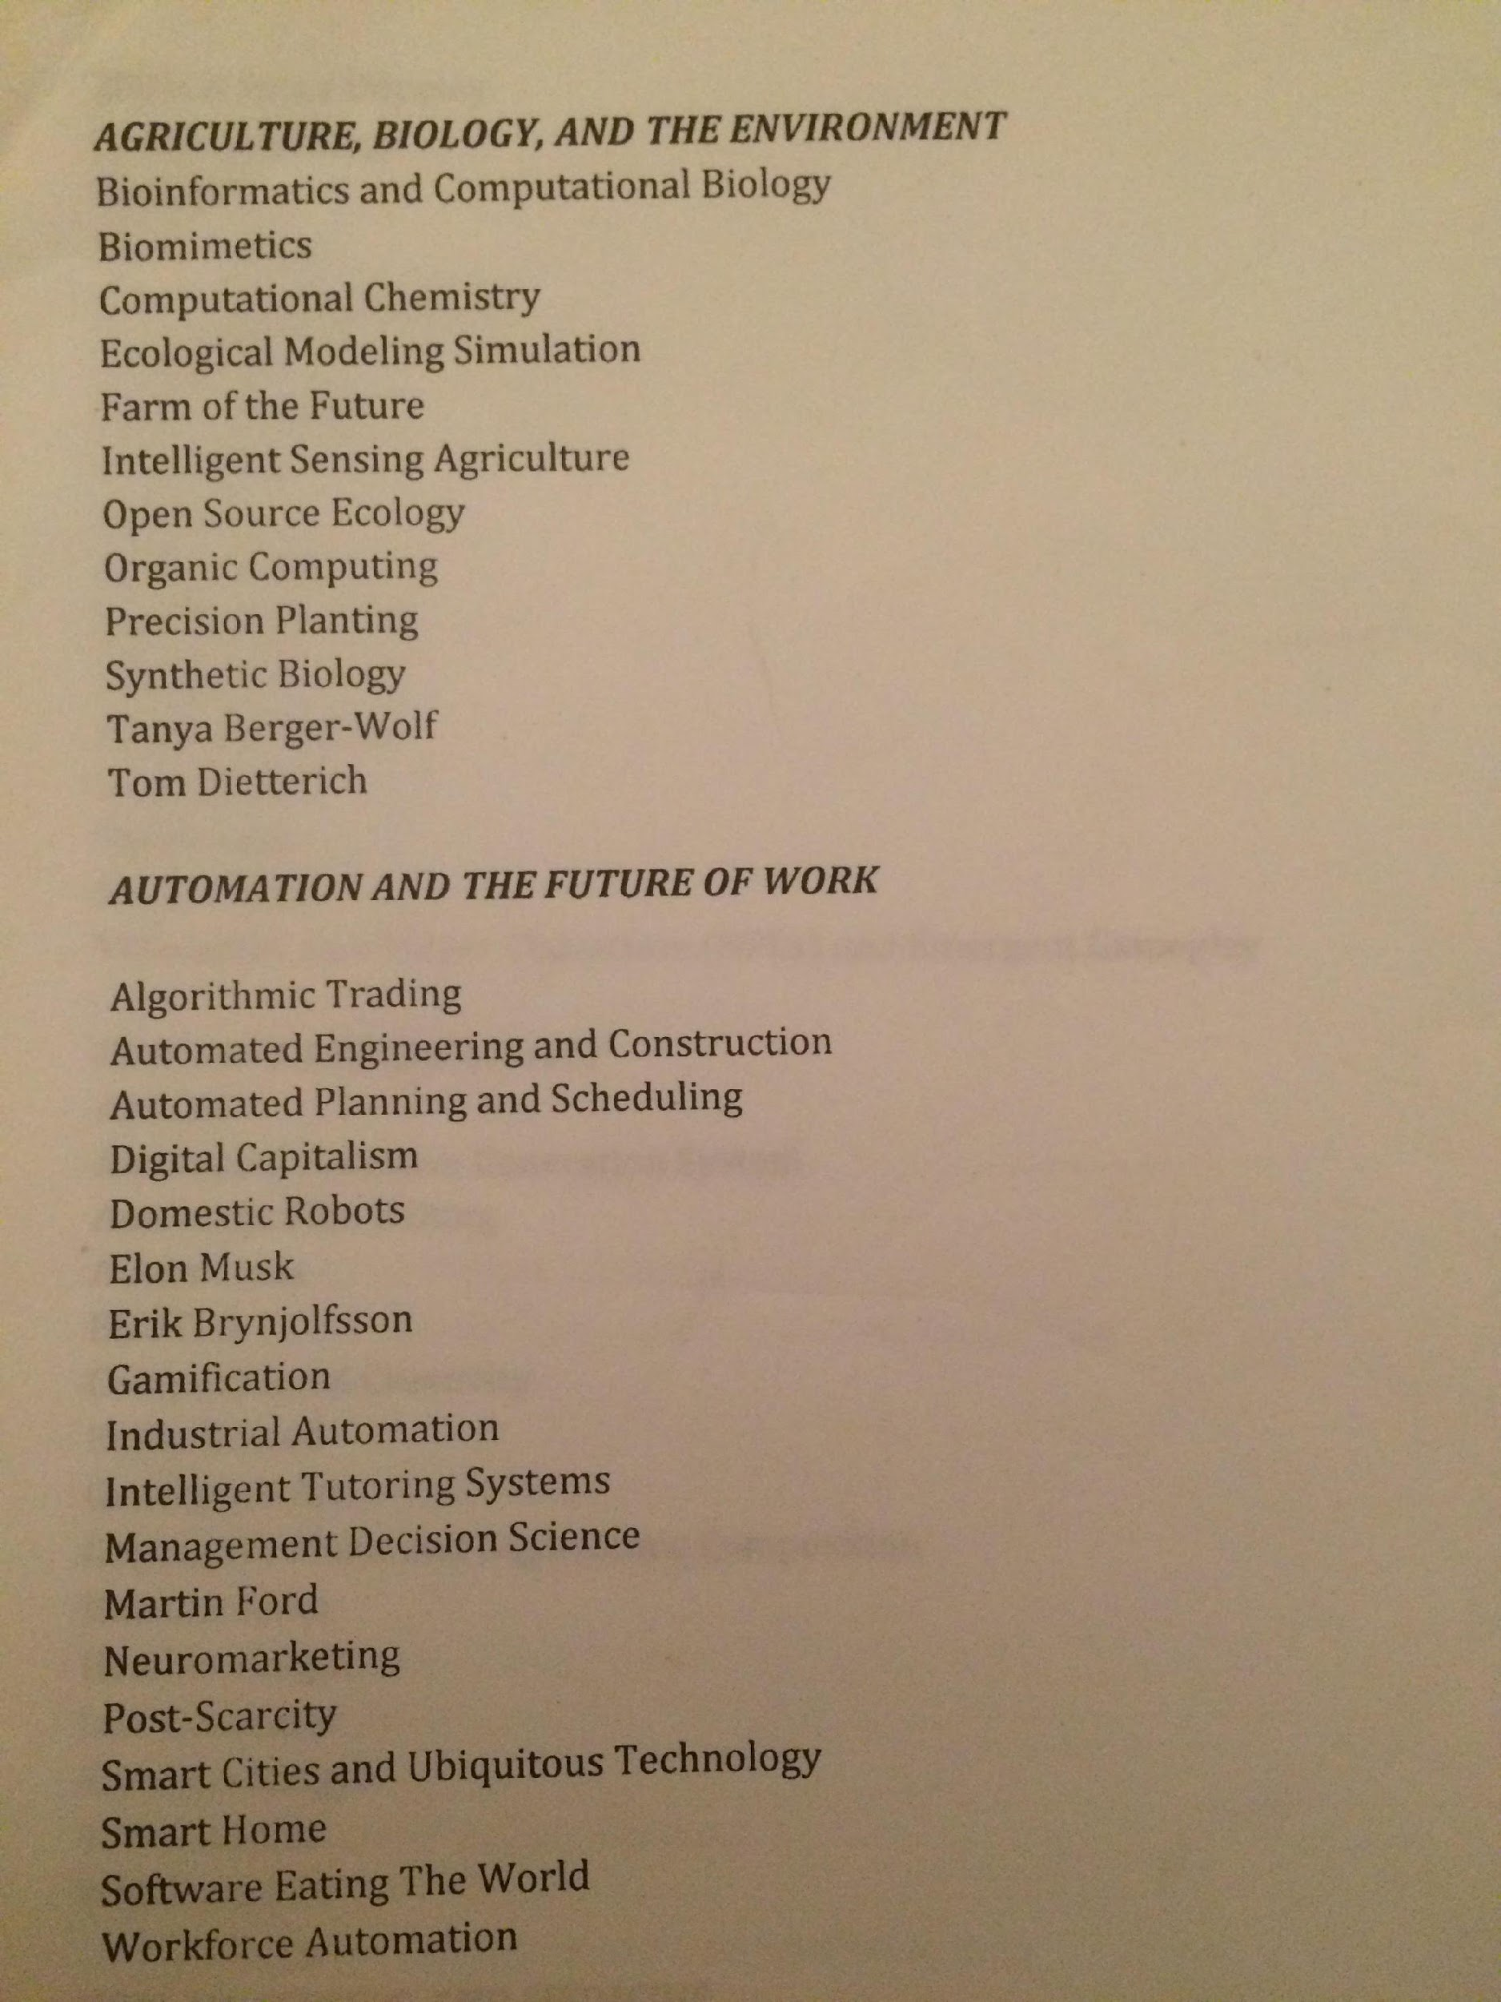
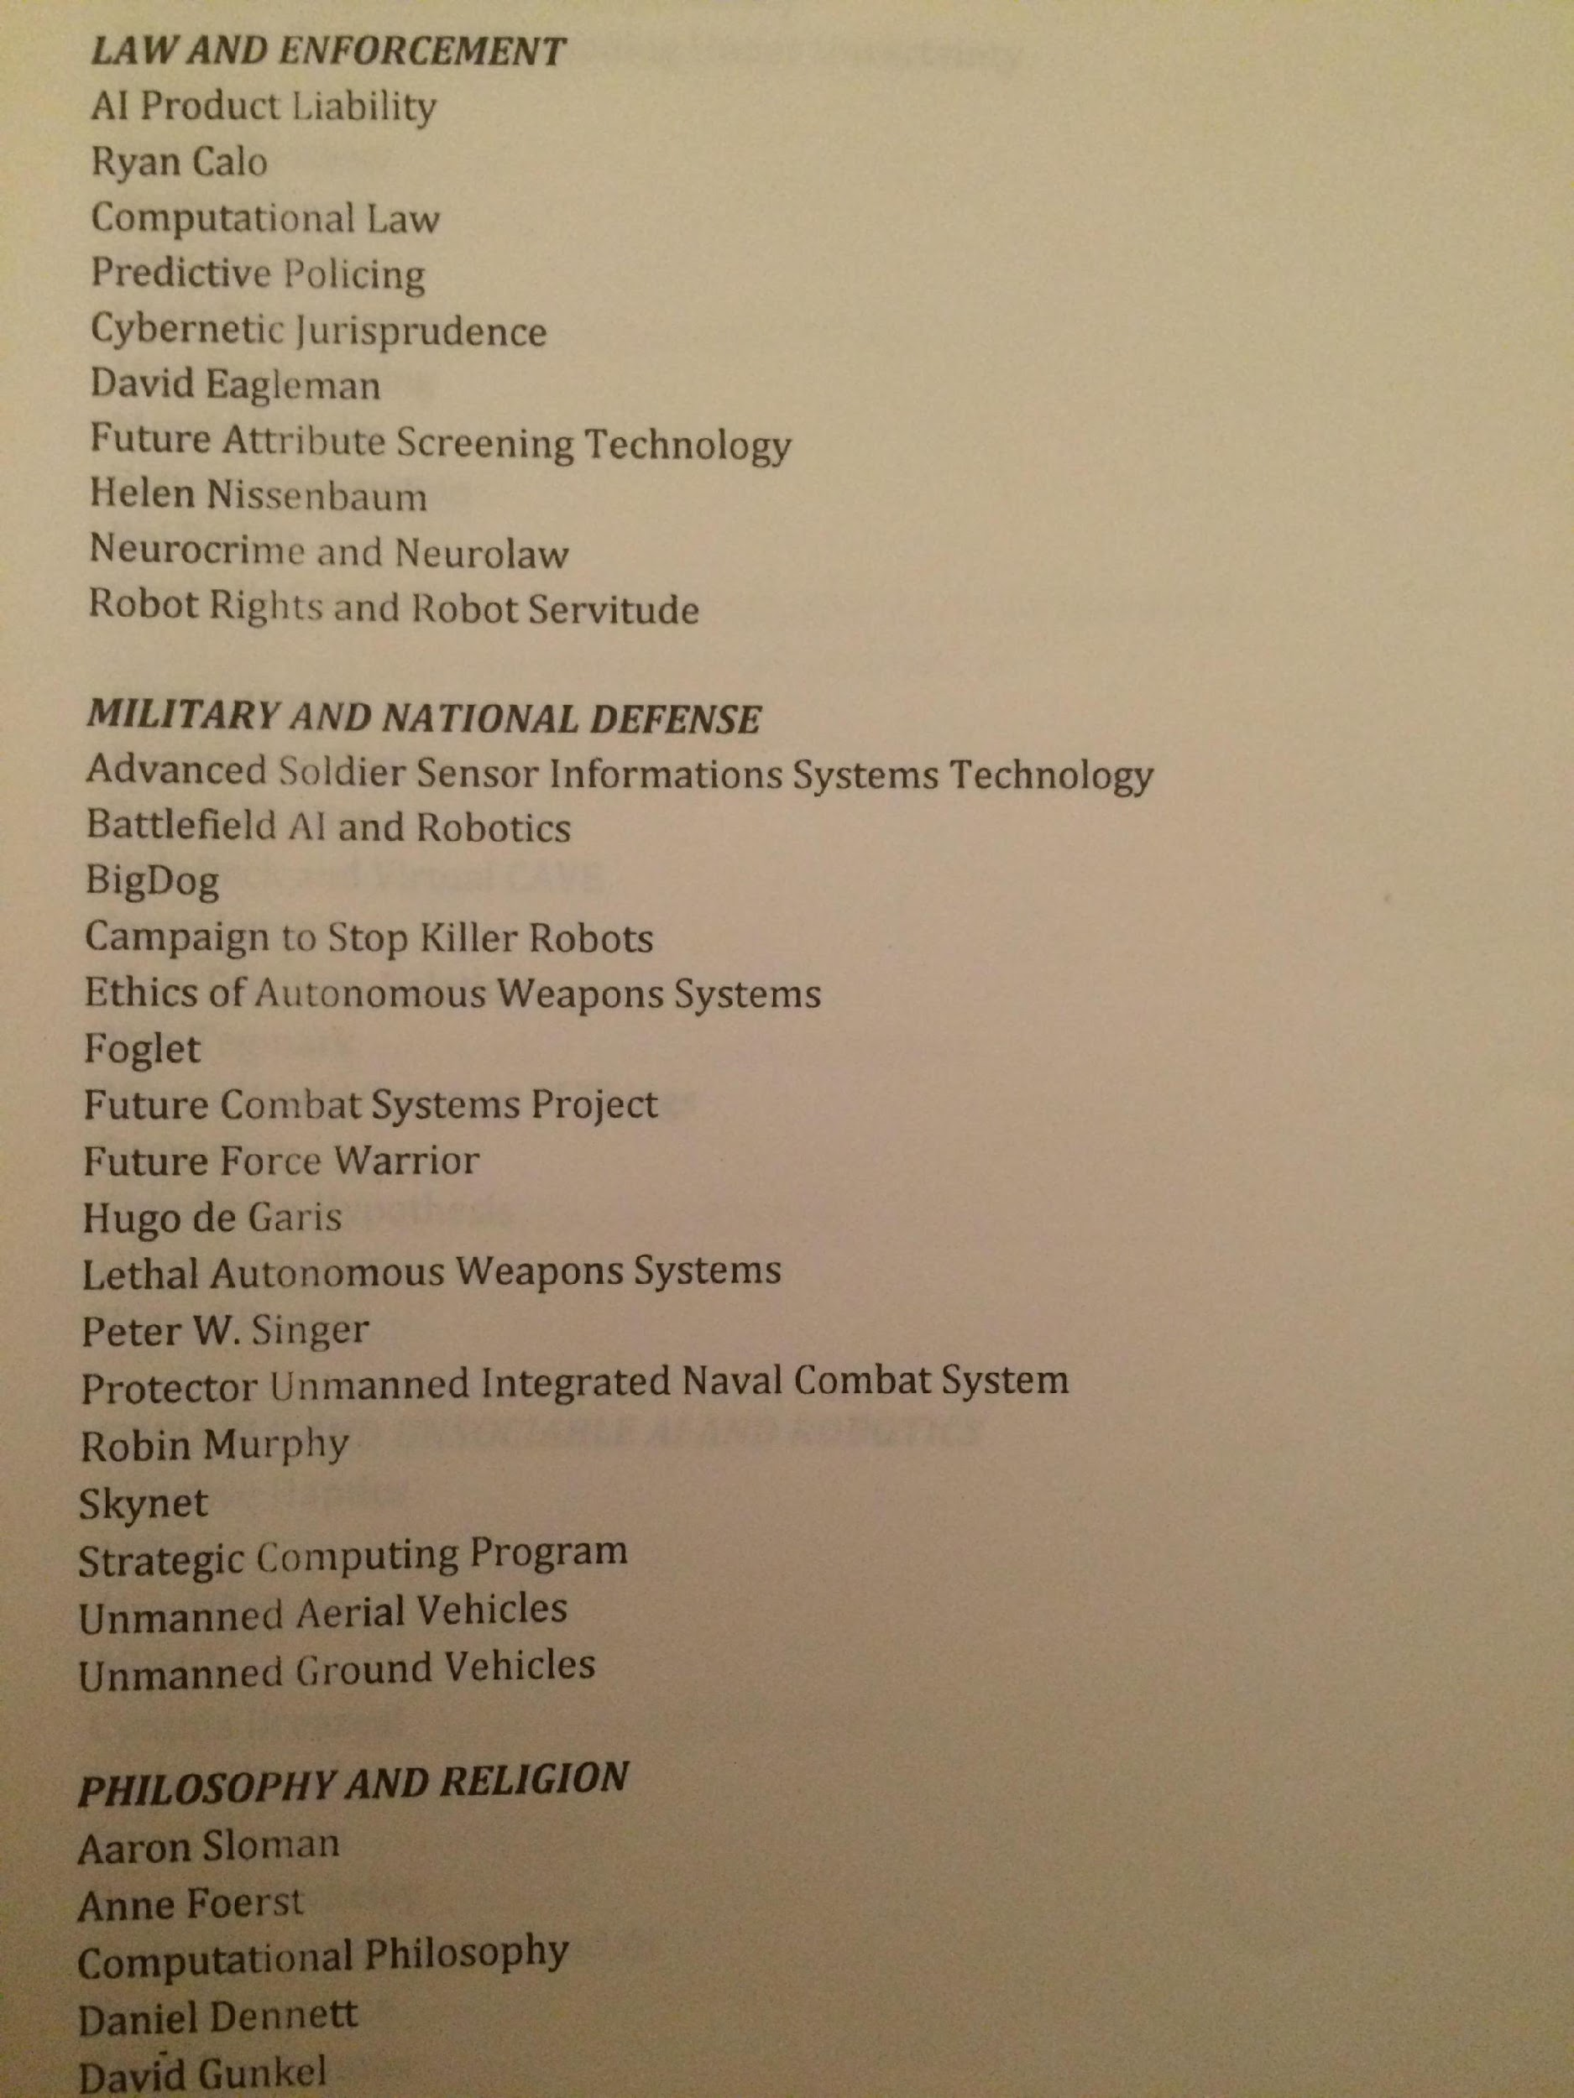
The Past, Present, and Future of Artificial Intelligence, Robotics, and Automation

Slide 12
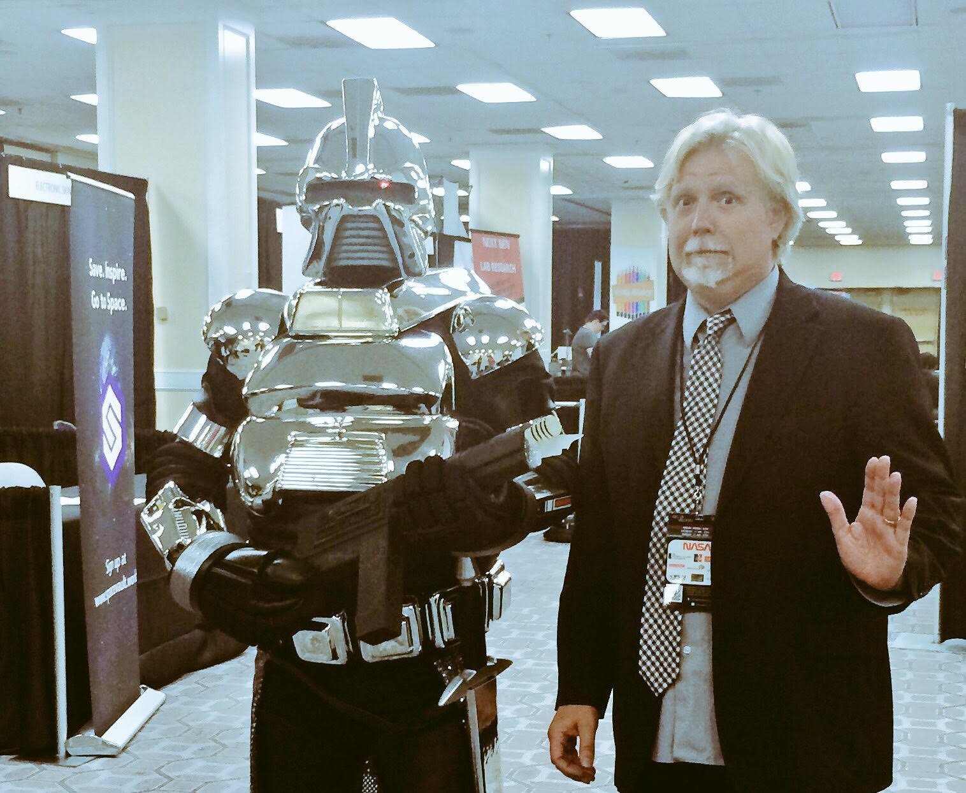
Escape Velocity Convention

Slide 13
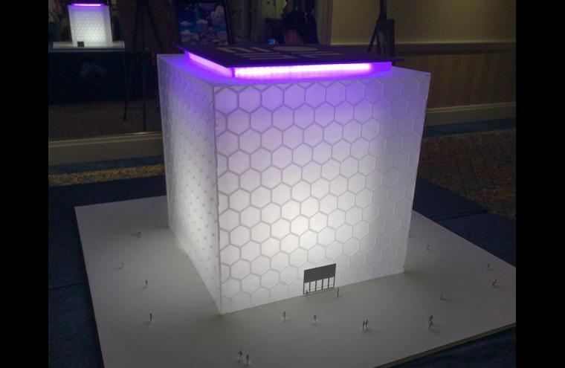
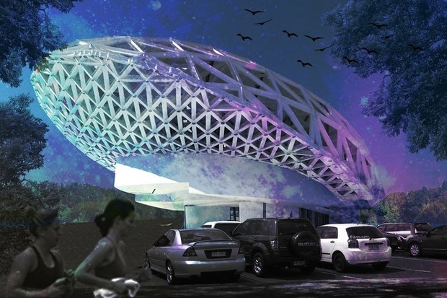
MOSF – Museum of Science Fiction

Slide 14
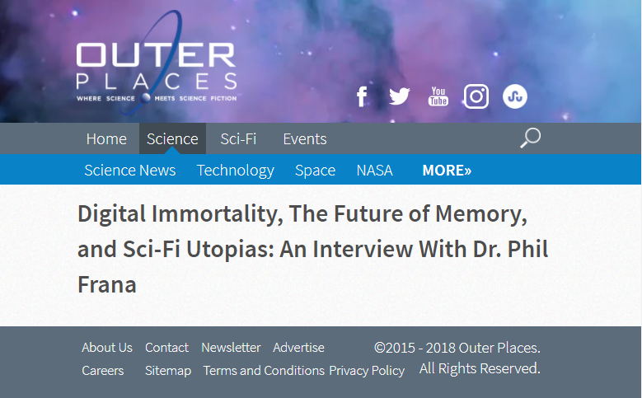
Media

Slide 15
FIN

