Slide 1

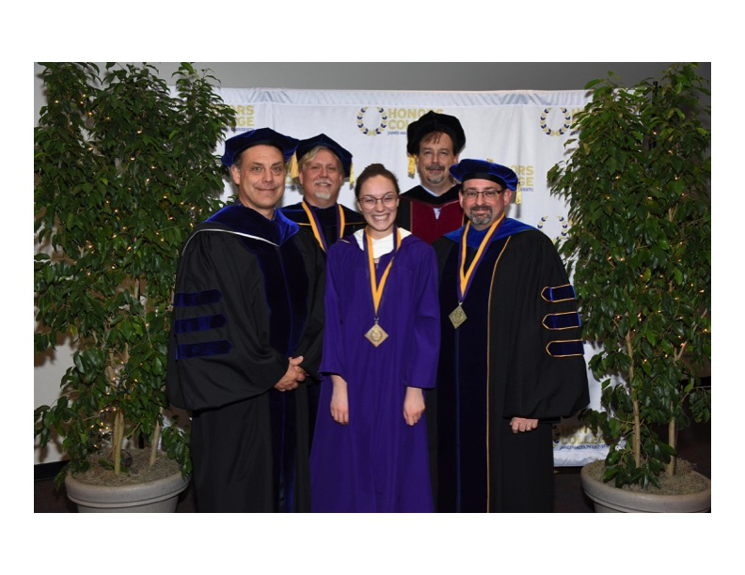

To provide students with a learning environment in which they develop and pursue self-designed curricular pathways and research goals, identifying unique domains of inquiry and interweaving multiple modes of thinking.
To empower students to cultivate their own academic and professional interests in ways that foster the ability to comprehend and contribute uniquely and innovatively to a wide array of topics, questions and problems.
Mission

Slide 2

Bachelor of Science
Independent Scholars
Non-profit and Private Sector Solutions to Environmental Challenges
Bachelor of Arts
Independent Scholars
Storytelling and Human Empathy
Bachelor of Science
Independent Scholars
Augmented Intelligence and Entrepreneurship

Slide 3
Curriculum Map
 |  | Learning Experiences
 |  | IND 200 | IND 300 Workshops | IS Curricula | IS Portfolio | Experiential study | IS Senior project
Student Learning Outcomes 1-6 | 1 - develop topic-based interests and inquiry strategies to pursue those interests | ✓✓✓ | ✓✓ | ✓✓✓ | ✓ |  | ✓✓✓
 | 2 - enhance creativity, self-directedness, and perseverance required for inquiry | ✓✓✓ | ✓✓ | ✓✓✓ | ✓✓ | ✓ | ✓✓✓
 | 3 - learn research, technical, and communication skills relevant to inquiry | ✓✓ | ✓✓✓ | ✓✓✓ | ✓✓ | ✓ | ✓✓✓
 | 4 - situate inquiry in relation to contemporary notions of disciplinary thinking | ✓✓ | ✓ | ✓✓ | ✓ |  | ✓✓✓
 | 5 - enhance aptitude and confidence in working independently and collectively | ✓✓ | ✓ | ✓✓ | ✓ | ✓✓ | ✓✓✓
 | 6 - apply knowledge and skills in experiential learning settings |  |  |  |  | ✓✓✓ | ✓✓✓

Slide 4
Assessing Growth Over Time
 |  | Proposal (Time 1) and Senior Project (Time 2) Evaluation Rubric
 |  | 1 - Beginning | 2 - Developing | 3 - Good | 4-Exemplary
Student Learning Outcomes 1-5 | 1 - develop topic-based interests and inquiry strategies to pursue those interests
 | 2 - enhance creativity, self-directedness, and perseverance required for inquiry
 | 3 - learn research, technical, and communication skills relevant to inquiry
 | 4 - situate inquiry in relation to contemporary notions of disciplinary thinking
 | 5 - enhance aptitude and confidence in working independently and collectively

Slide 5
Student growth in first 3 cohorts
(measured at end of gateway IND 200 course)
 |  | 2015 (n=5) |  |  |  | 2016 (n=9) |  |  |  | 2017 (n=5)
 | B = Beginning D = Developing G = Good E = Exemplary | B | D | G | E | B | D | G | E | B | D | G | E
Student Learning Outcomes 1-5 | develop topic-based interests and inquiry strategies to pursue those interests |  | 2 | 2 | 1 | 5 | 2 | 2 |  |  | 3 | 2
 | enhance creativity, self-directedness, and perseverance required for inquiry | 1 |  | 1 | 3 | 1 | 4 | 4 |  |  | 4 | 1
 | learn research, technical, and communication skills relevant to inquiry |  | 2 | 1 | 2 | 3 | 5 | 1 |  | 1 | 2 | 2
 | situate inquiry in relation to contemporary notions of disciplinary thinking | 1 | 2 | 2 |  | 5 | 3 | 1 |  | 2 | 2 | 1
 | enhance aptitude and confidence in working independently and collectively |  | 1 | 1 | 3 | 2 | 2 | 5 |  |  | 2 | 3

Slide 6
What ideas consist of
Student’s Topic of Inquiry | Key Disciplines | Experiential study
Mindfulness and Integrated Art | ANTH, PSYC, REL, THEA | Ghana Study Abroad, Emerging Creatives Collaborative project
Storytelling and Girlhood Identity | ENG, SMAD, ART, ANTH | Documentary filmmaking
Theater for the Community: A Practical Application | THEA, EDUC, PSYC, MGMT | Theater and Community Outreach
Artificial Intelligence and Ethics | ISAT, COB, ANTH, PSYC | Blackbox AI internship
Photojournalism and Social Justice | JUST, ART, ARTH, SOCI | Ireland Study Abroad
Sustainability and Society | ISAT, PSYC, ECON, SCOM | Study Abroad in Korea, Sustainability in Germany, Clean Cities internship
Performing Arts for Healing, Social Change and Education | THEA, ANTH, SOCI, SOWK | Children's Theater, Russia Study Abroad
Biomedical Illustration and Art | BIO, ART, HTH, NUTR
Education Accessibility and Advocacy | EDUC, POSC, SOCI, PPA | Children's Museum internship
The Performing Arts and African/Latin American Identity and Culture | REL, ANTH, THEA, JUST | Study abroad in Salamanca
Business Analytics and Decision-Making | BSAN, ACTG, ECON, PHIL

Slide 7

Growth of an idea
Vision of a profession
A deeply-formed impression
“How to”
Screenplay Writing, Video Production
Documentary filmmaker
Storytelling enhances empathy
Software designer
Principles of Programming
Augmented intelligence will revolutionize health
Mindfulness can transform creative expression
Theater director
Acting: Scene Study

Slide 8
adjustments
Curricular revision: reading, reflection
Share & critique & presentation
Checkpoints, faculty review, mentors, advising

Slide 9
Contact
Director: Matthew Chamberlin
https://www.jmu.edu/honors/independent-scholars-major.shtml

